Slide 1
Content Based Music Genre Classification using Temporal and Spectral Features
Presented By:
Sidhdharth Pandya
Advised By:
Dr. Moayed Daneshyari
Computer Science Department
California State University, East Bay

Slide 2
Motivation:
Almost everyone listens to music. It propagates feelings and thoughts between people. Today's music corpus is very heterogenous in nature. Everybody has their own music taste mainly because of the diversity of composers and musicians out there.
Many music streaming services like Spotify, Amazon Music, Pandora etc. uses a state-of-the-art (SOTA) algorithms to find similarities and patterns in the music tracks and based on that, tracks are categorized into different classes known as 'Genres' of the tracks. Based on the genres one listen to, the algorithm can recommend related songs.
As music listeners, we are motivated to get insight into some of the existing music classification techniques and try out experiments using different machine learning algorithms and see if we can improve any of these existing techniques.

Slide 3

Industrial Use:
Several companies uses music classification to segment the database (of songs) according to genre and either, recommend songs accordingly to their users (like done by Spotify, YouTube Music etc.) , or even as a product (like Shazam).
As there are numerous machine learning techniques that work well on extracting patterns, trends and other useful information from a large set of data, these techniques are used in the industry to perform music analysis.

Slide 4
Other Approaches:
Besides the content-based music genre classification, other techniques exists as well such as :-
Collaborative filtering – This approach makes a prediction about the taste of a user with the help of part of the community that shares the same (or similar) taste (thus called collaborative). An important assumption is made that if a user say A listens to the same songs of a genre as the users B, C, D and E, then A would also prefer the songs of other genres listened to by B, C, D and E.
Drawback – For the collaborative filtering approach to work, there must be a large set of users (i.e. the community) and user data.
Knowledge-based – This approach draws in user interests and feedback at regular periods. This technique is used mainly when the other two (content-based and collaborative filtering) cannot be applied.
Drawback – This approach is too much dependent on user feedback (an example is the like and dislike option provided by Spotify for each song). Thus, inadequate feedbacks or unable to obtain feedbacks regularly hinders the working of the approach.
Notes:
Collaborative – if A,B,C,D listen to same genre then A would also like the songs B,C,D listen to. Con: need larger dataset
Knwoledge – take feedback from user at regular periods. Con: tto much dependent on user’s feedback

Slide 5
Our Approach: Content-based
This approach focuses on content or item similarity. It analyses the past interactions of the user (in our context, the songs that the user listened to) and if the interactions were positive, then recommends similar items to the user.
Though this approach leaves a little room to surprise the user with an out of the box suggestion, but it still works well.
As this approach does not rely on community and also, does not involve the use of feedbacks, thus it overcomes the drawback of both collaborative-filtering and knowledge-based filtering approaches.

Slide 6
About the Dataset
The dataset used in the project is the GTZAN dataset available at the MARYSAS website. This dataset was originally used in Musical genre classification of audio signals(IEEE-2002).
The dataset is made up of about 1000 audio tracks each of which is 30 seconds long. There are about 10 genres, each covering up 100 tracks for each genre. All tracks has 22050 Hz sampling rate, mono channel with 16-bit sample audio files in .wav format.
The audio files were gathered using different sources like CDs, radio, microphone recordings etc. to represent a variety of recording conditions.

Slide 7
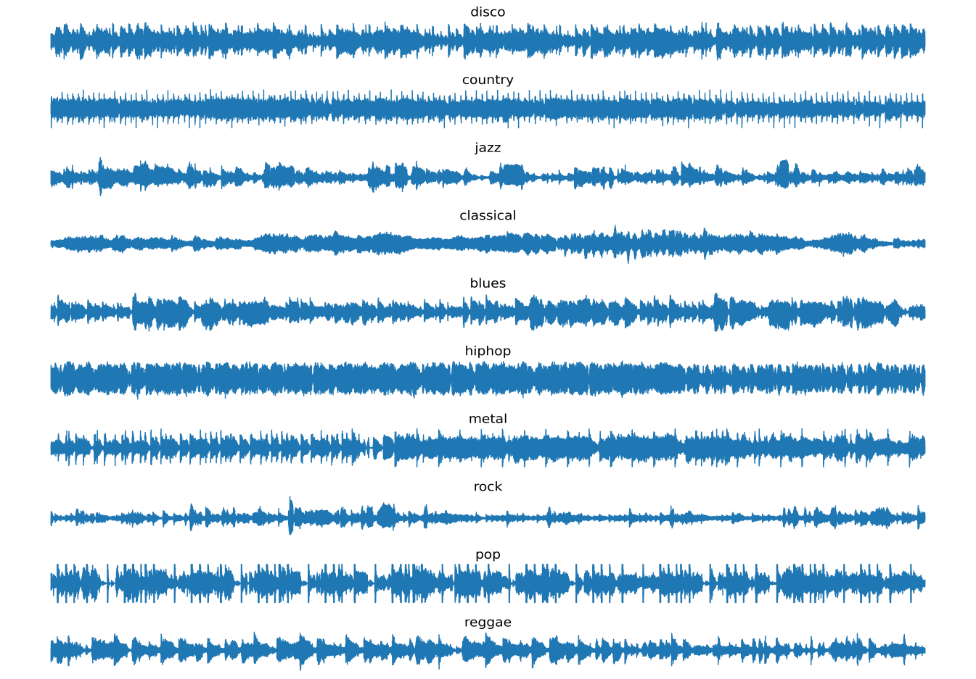
Problem Formulation: Music Genre Classification as Time Series Classification.
The figure represents sample waveforms from the different music genres. As we can see that the waveforms are complex, and for it to be interpreted in a meaningful way, by a system, several audio
signal processing steps, need to be applied, in order to prepare the dataset on which a classifier model can be learnt.
However, from the figure, it can be intuitively observed the genres can be differentiated based on the waveforms
Figure: Waveform plot of randomly selected one song for each genre from dataset.

Slide 8
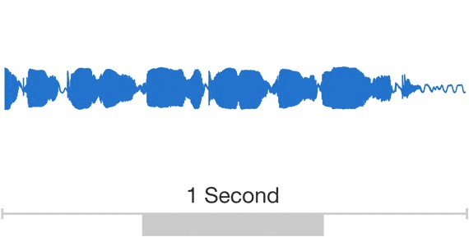
Audio Representation in Computer Memory:
In computer memory, audio track is represented as arrays of samples where each array represents an audio channel and each sample in an audio channel can be an instance of double, float or signed integer variable depending on the audio depth quality we want to retain.
Mono audio tracks have one array, stereo audio tracks have two arrays. There can be more than two channels too. GTZAN has only mono channel tracks.
How many samples for 1 second audio? (Sample Rate)
Well, It depends on the sampling rate.
For GTZAN dataset, each audio tracks has sample rate (sr) = 22050 Hz. (meaning: 22050 array elements per second)
Figure: Taken from WaveNet blog by deepmind

Slide 9
Fine Grained Audio Features:
Amplitude
Frequency
Phase Angle
Pitch (Related to Frequency)
Tonal Features
Amplitude Envelope
Power of Signal
Audio Representation In Different Domains:
Time Domain (Time vs Amplitude Plot)
Frequency Domain (Frequency vs Amplitude Plot)

Slide 10
Signal (Audio) Representation In Time Domain:
NOTE: In this figure, sample rate is 2000 Hz.
When two or more signals are added, the resultant signal is very tangled, and it is hard to decompose it in time domain.
But hopefully, we can approximate the complex signal by decomposing it in the frequency domain.

Slide 11
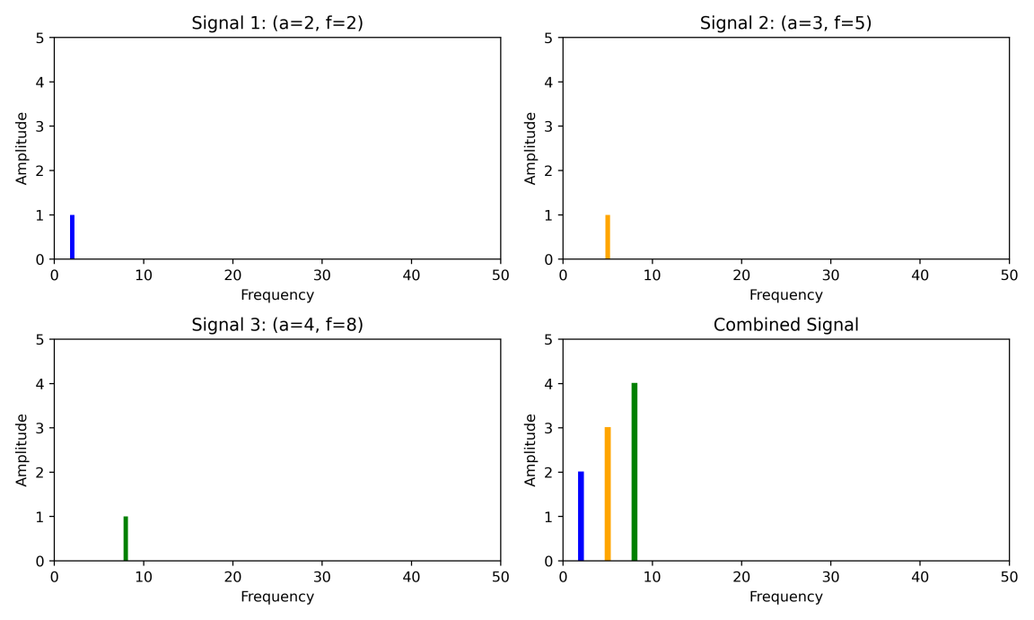
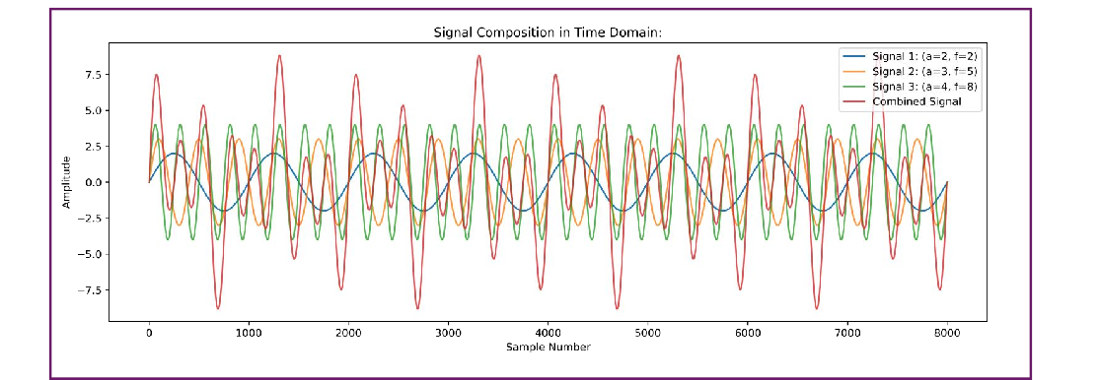
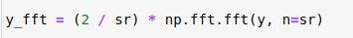
Audio Representation In Frequency Domain:
FFT
FFT NumPy code:
But this captures the global features !!!
Using Fourier transform of a signal, we can get its frequency domain representation.
Decomposition is very easy in frequency domain compared to time domain.
NumPy provides an FFT implementation which is optimized.
In Fourier Transform, we get similarity of our signal with complex signal with different frequencies. And quantification of this similarity gives the amplitude in the frequency domain.
Similarity is given by:
{ 2 * dot(exp(-i x 2πft), Y) } / N

Slide 12
Windowed Feature Extraction of Signals:
t = 1
t = 2
t = 3
t = T
Hop Length
Window Length
 |  |  | - - -
 |  |  | - - -
 |  |  | - - -
| | | | | | | | |  | | |
| | | | | |  | |
 |  |  | - - -
N examples
(t timestamps)
We are mostly interested into finding non-stationary patterns in the audio signals. As simple FFT gives information about whole track, it finds the global features. But, with some modification of FFT will give us very nice temporal features!
Modification: Find the local features by windowing method with stride equal to Hop Length.

Slide 13
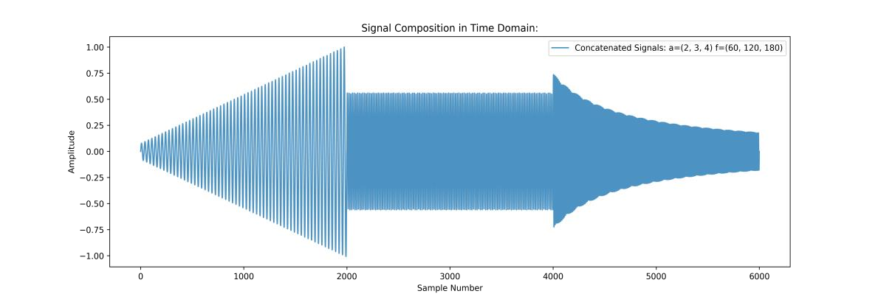

Spectrogram: Array of local FFT features
Signal in time domain:
t=1 | t=2 | t=3 | - - - | t=T
D Features
Spectrogram view of above signal:
Frequency
(t timestamps)
Spectrogram captures this naturally.
Time
For spectrograms, time resolution and frequency resolution is a tradeoff.
We want Smaller D without losing the higher frequencies.
But if we use spectrogram, the dimensionalit y of features will be very large.

Slide 14
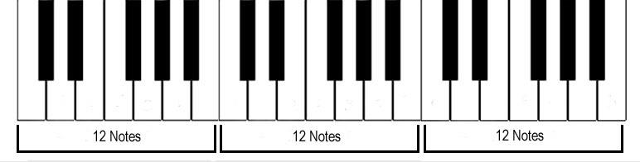
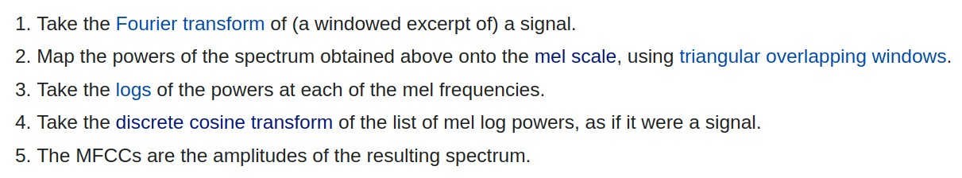
Mel(ody) Spectrogram:
Human perception for audio frequencies and audio gain is non-linear in nature. Spectrogram captures the linear scale. So, MEL-Spectrogram rescales the frequency axis using mel-scale.
A4
A5
A6
440 Hz
880 Hz
1760 Hz
Another type of features which has low dimensionality is MFCC features. It emerged from speech processing domain. It is related to Mel-Spectrogram but robust to the noise.

Slide 15
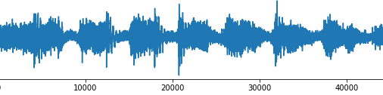
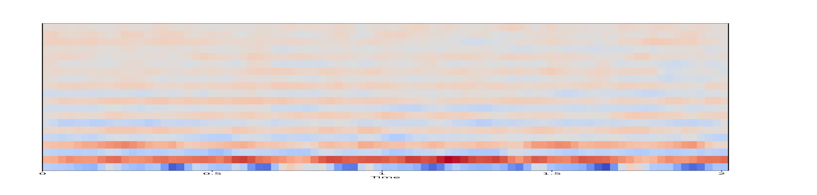
MFCC Visualization:
D=20 Features
Timestamp
The MFCC Features captures the details about the envelope in IDFT of the Log Power Spectrum.
We will consider 20 MFCC Coefficients.

Slide 16

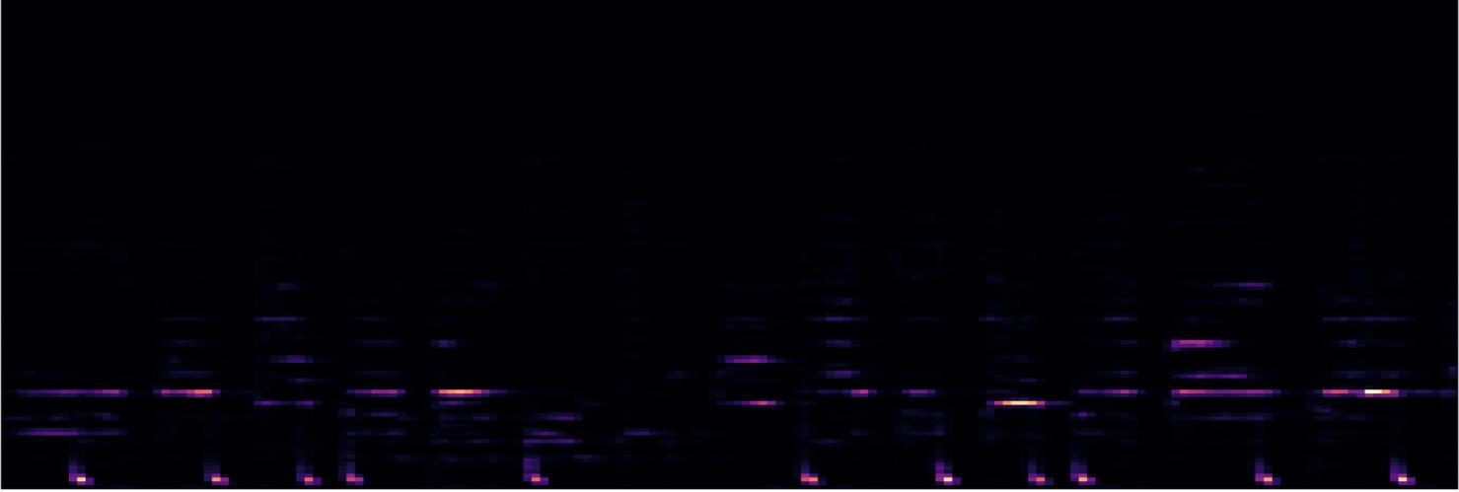
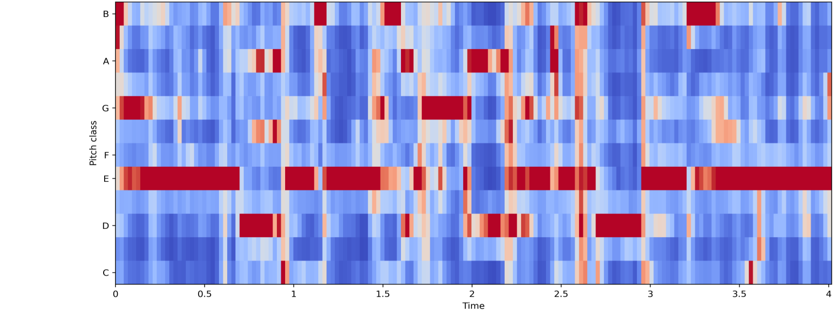
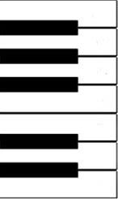
Chroma Features:
Chroma feature captures the tonal features from local window.
It finds the most dominant tone from 12 tones. So, Per window Its dimensionality is 12.

Slide 17
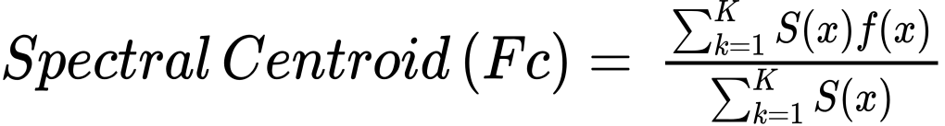
Spectral Centroid:
It captures the average spectral frequency weighted by intensity.
Its dimensionality is 1 per window.
Spectral Contrast:
It considers the spectral peak, the spectral valley, and their difference in each frequency sub band.
Its dimensionality is 7 per window.

Slide 18
Total Number of features per window: (Total No of Windows = No of timestamps)
MFCC: 20,
Chroma-STFT: 12
Spectral Centroid: 1
Spectral Contrast: 7
So, Total features per window = 40.
(N, T, D) = (5000, 256, 40)
Dimension of Features for the dataset:
Length of Each Track: 30 sec Sample Rate: 22050 Hz
Window Size: 2048 samples
Hop Length: 512 samples
Total Timestamps = (30 * 22050 - 512) / 512 = 1287
We are using LSTM for Sequence Classification It works well for around 400-500 timestamps. So, we will split a track into 5 segments. Now we use all new created segments as additional examples. This is how a kind of Data Augmentation is performed.
After Augmenting the dataset:
Length of Each Track: 6 sec Sample Rate: 22050 Hz Window Size: 2048 samples Hop Length: 512 samples
Total Timestamps = (6 * 22050 - 512) / 512 = 257
We will select 256 timestamps and ignore the last timestamp to roundoff the sequence length to 256.

Slide 19
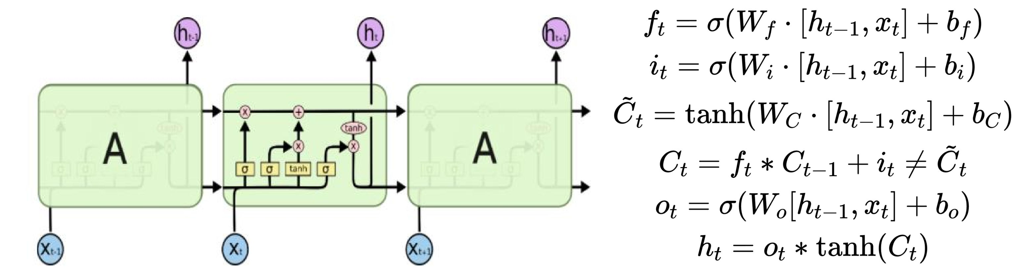
LSTM Networks
LSTM are ideal for sequential data, where order is important. Long term dependencies can be preserved with the help of loops, containing four interacting layers.
Source: https://colah.github.io/posts/2015-08-Understanding-LSTMs/
The repeating module in an LSTM contains four interacting layers

Slide 20
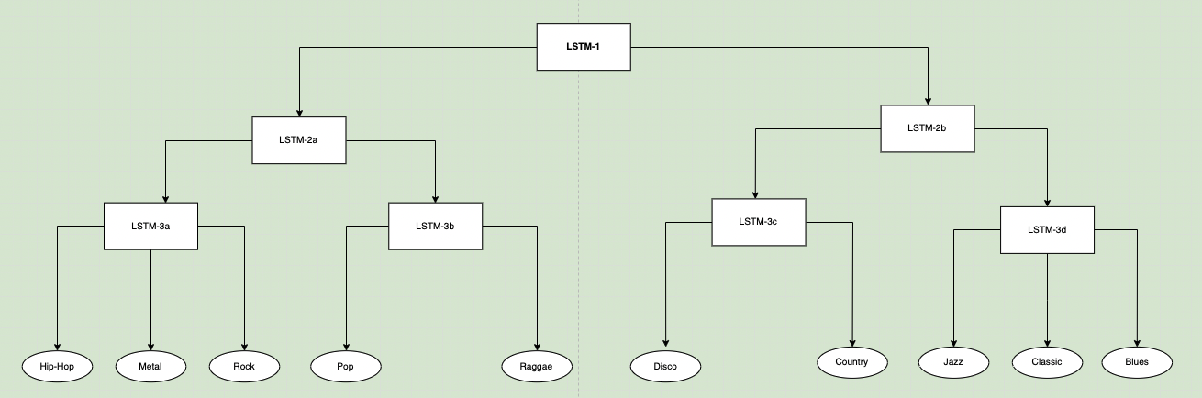
Hierarchical LSTM Architecture
Adopted from [2] (Tang et al.) with some modifications.

Slide 21
Functionality of the LSTM classifiers
LSTM1: It classifies between strong (hip-hop, metal, pop, rock, reggae) and mild (jazz, disco, country, classic, blues)
LSTM2a: It classifies between sub-strong1 (hip-hop, metal, and rock) and sub-strong2 (pop and reggae)
LSTM2b: It classifies between sub-mild1 (disco and country) and sub-mild2 (jazz, classic, and blues)
LSTM3a: It classifies between hip-hop, metal and rock
LSTM3b: It classifies between pop and reggae
LSTM3c: It classifies between disco and country
LSTM3d: It classifies between jazz, classic, and blues.
This hierarchical architecture, helps to tackle the multi-class classification problem, by a divide and conquer based approach, where each LSTM in the tree, is trained using samples of the relevant classes. The idea for the hierarchical LSTM model was adopted from the paper.

Slide 22
Architecture of the LSTM networks
Input Layer | 20 MFCC, 12 Chroma-STFT, 1 Spectral Centroid, 7 Spectral Contrast, total 40 features obtained as input
Hidden Layer I | 64 LSTM units
Hidden Layer II | 32 LSTM units
Output Layer | Number of units depends on which the number of fan-out results. for example, LSTM 3a, will have 3 softmax units whereas LSTM1 will have 2 softmax units.
Library Used for implementation: Tensorflow

Slide 23
Train, Test Split:
We are doing K-Fold Cross Validation with K = 6.
Before Splitting:
After Splitting (Train, Val, Test):
LSTM 1: | 5000 |  | 3750 | 750 | 500 | (Stratified)
LSTM 2a: | 2500 |  | 1500 | 300 | 200 | (Stratified*)
LSTM 2b: | 2500 |  | 1500 | 300 | 200 | (Stratified*)
LSTM 3a: | 1500 |  | 1125 | 225 | 150 | (Stratified)
LSTM 3b: | 1000 |  | 750 | 150 | 100 | (Stratified)
LSTM 3c: | 1000 |  | 750 | 150 | 100 | (Stratified)
LSTM 3d:
1500
1125
225
150
(Stratified)
* indicates that explicitly Stratified by ignoring some examples. To avoid class imbalance.

Slide 24
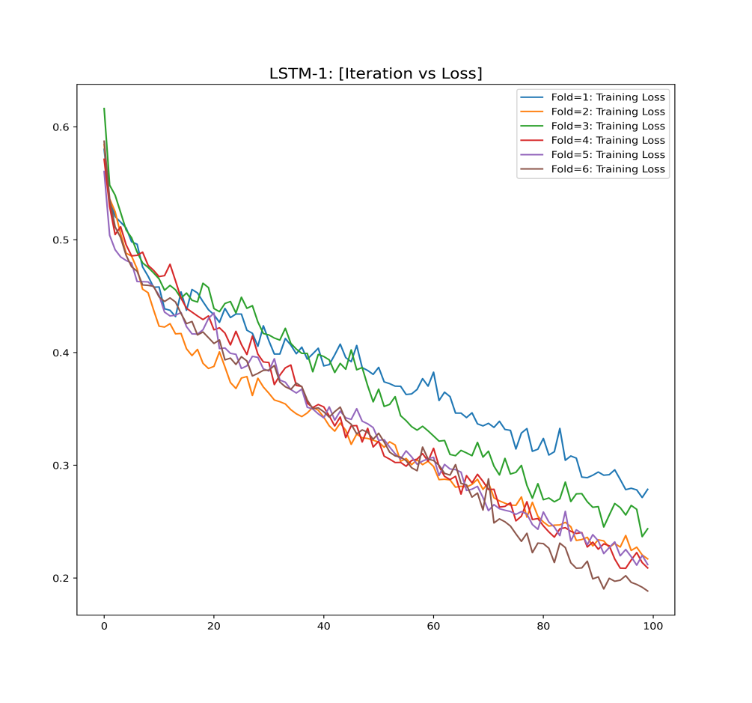
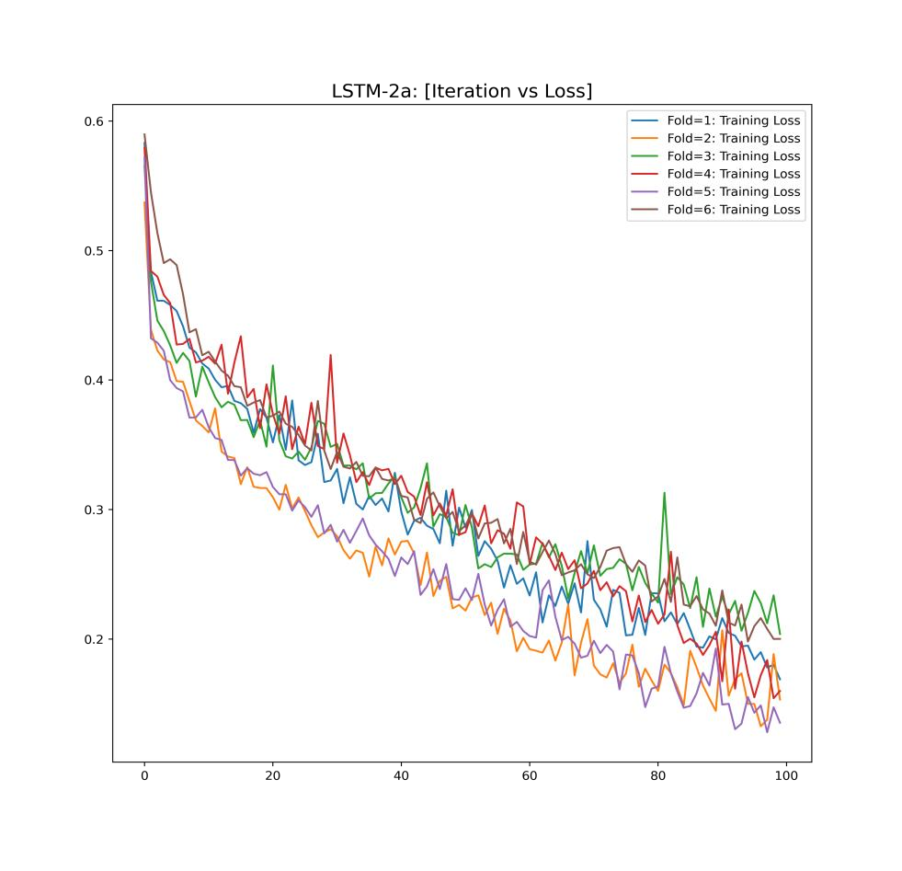
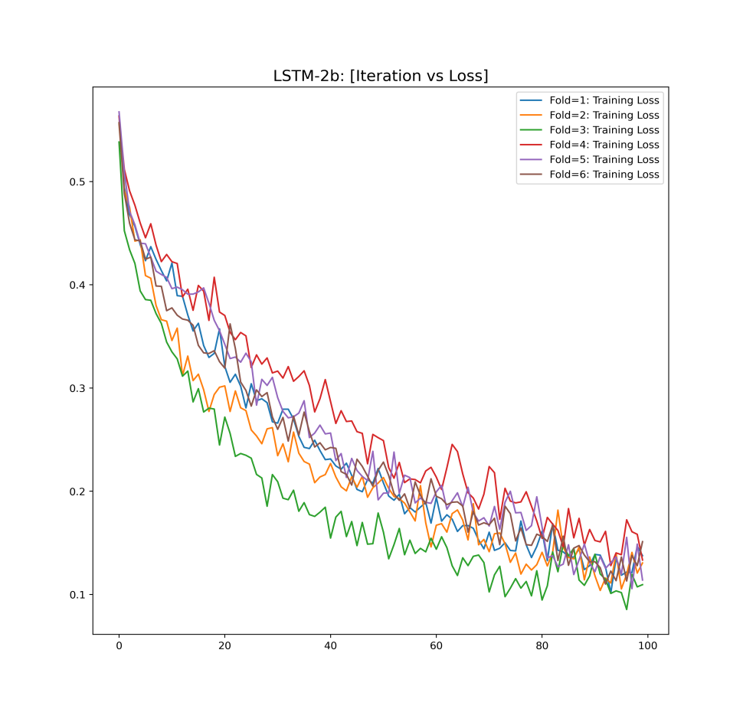
Iterations vs Cost Plots:
LSTM 1:
LSTM 2a:
LSTM 2b:

Slide 25
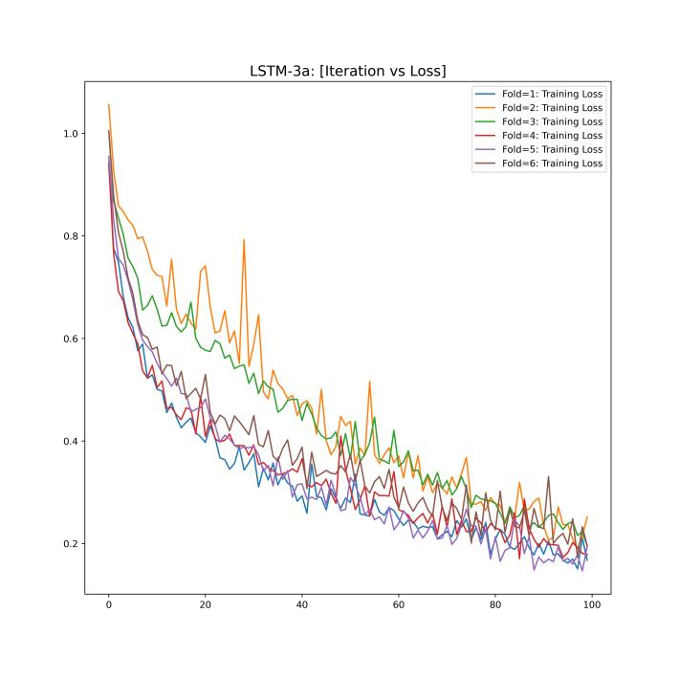
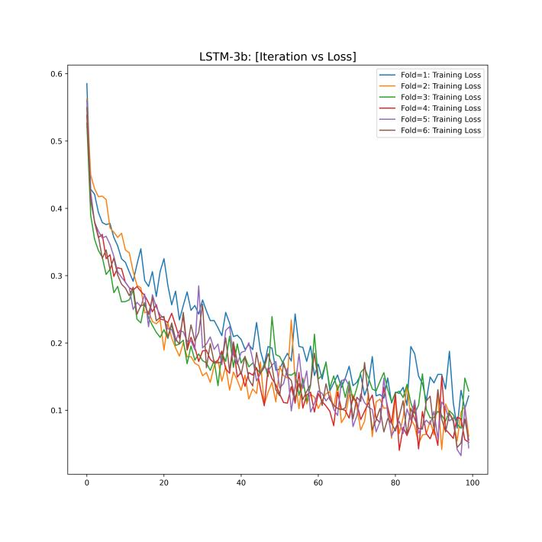
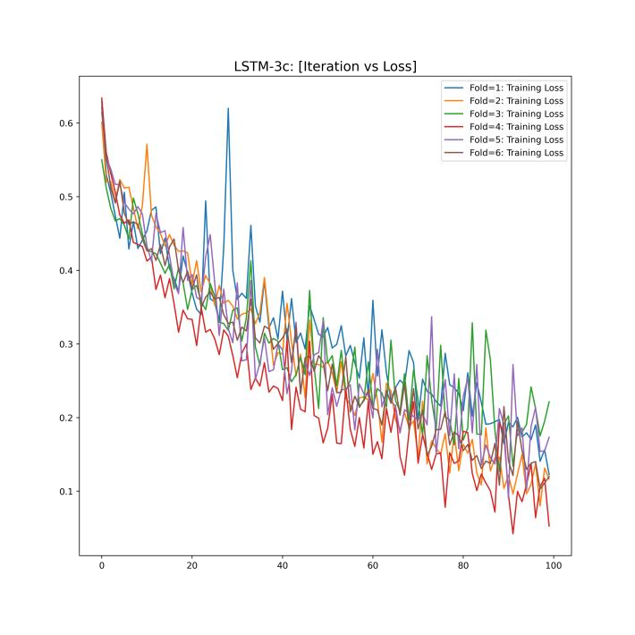
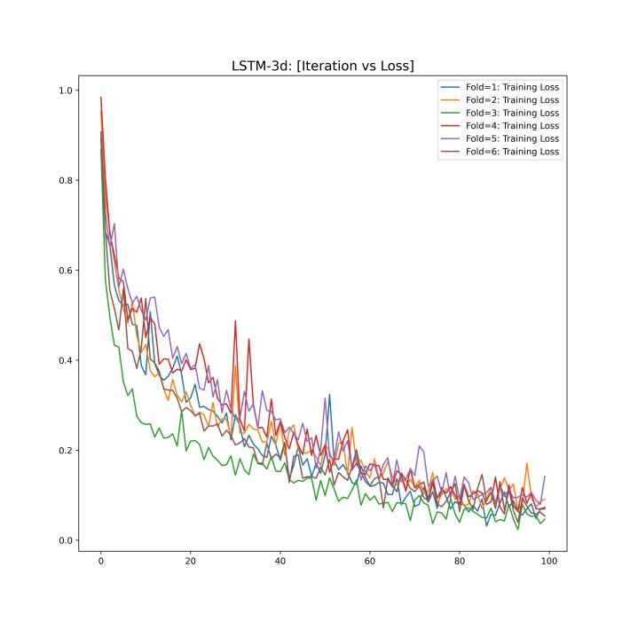
Iterations vs Cost Plots: [LSTM 3a, LSTM 3b, LSTM 3c, LSTM 3d]
LSTM 3a:
LSTM 3b:
LSTM 3c:
LSTM 3d:

Slide 26
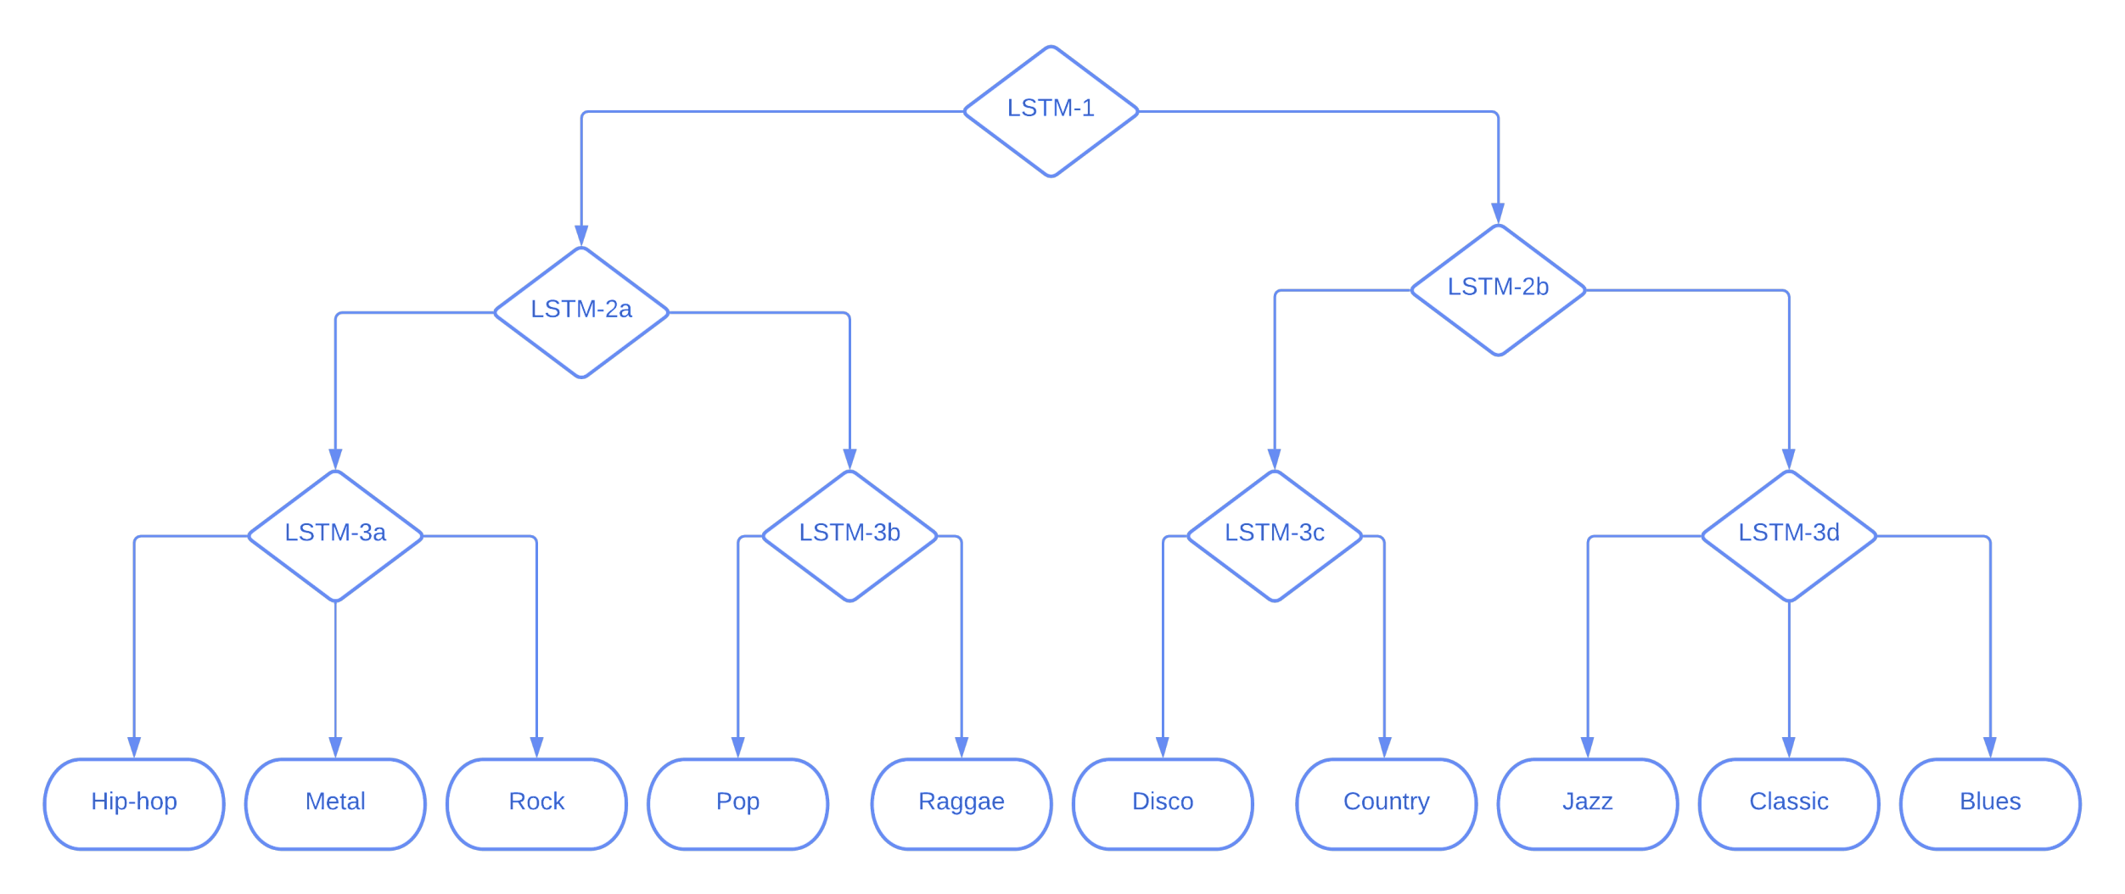
Prediction Methods:
1: Hard Prediction
1: In this, we perform segmentation on the original track so that each segment will have 256 timestamps after feature extraction.
2: Predict the class for each segment.
3: Select label with highest frequency.
4: For all segments, select the path with majority predicted label.
5: Repeat for all internal nodes until leaf nodes are not predicted.
6: Return the predicted label.
2: Soft Prediction
1: In this, we perform segmentation on the original track so that each segment will have 256 timestamps after feature extraction.
2: Predict the class for each segment.
3: For each segments, choose path independently.
4: Do this for all internal nodes until leaf nodes are not predicted.
5: Return all predicted labels with the frequencies.

Slide 27
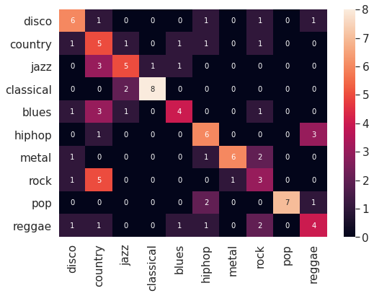
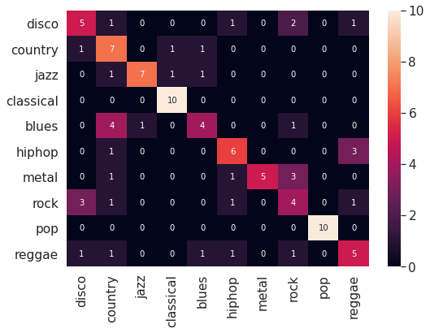
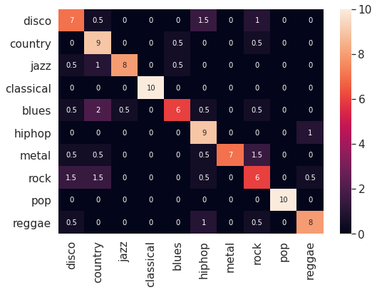
Results Evaluation:
Hard Prediction
Soft Prediction (Top-1)
Soft Prediction (Top-2)
Accuracy: 54%
Accuracy: 63%
Accuracy: 80%
As we can see that using hard prediction method, accuracy is as good as mentioned in [2]. Using soft prediction method, it improved from 53 % to 63 %. And using top-2 predictions it is improved to 80%.

Slide 28
Conclusion:
The content-based music classification approach is being used in the industry widely.
As there are numerous machine learning techniques that work well on extracting pattern, trends or other useful information from a large dataset, thus these techniques are suitable for performing music analysis.
Several companies are using music classification to segment their database according to genre and are either using it to recommend songs to their users like done by Spotify, Youtube Music etc. or even purely as a product like Shazam.
Evaluation Metric | Multi-Layer Perception | CNN with Max-Pooling | RNN with Long Short-Term Memory | Hierarchical LSTM
Training Accuracy | 73.12 | 86.58 | 77.57 | Inference Hard- 75% Inference Soft- Top-1 – 84% Top-2 – 95%
Testing Accuracy | 58.85 | 73.54 | 69.23

Slide 29
Future Work
A shortcoming of content-based approach is that it fails to account for the cultural as well as contextual meaning of the item (in our case song) and only look for similarity between the items. Also, with the content-based approach, there is little room left for surprise as out of the box recommendations are not done with this approach which can help the user to explore his/her taste.
We plan to integrate our content-based approach with the collaborative filtering method so as to overcome the above two shortcomings. This will also provide us with the added benefit of using the information collected from the community.
We also plan to introduce a feedback mechanism which would allow us to draw in feedback from the users and thus improving the current approach even further.

Slide 30
Tools and Libraries Used:
1: Librosa (To extract features)
2: TensorFlow (To create LSTM models)
3: Matplotlib (To create plots)
4: NumPy (To compute mathematical functions)

Slide 31
References:
Charu C. Aggarwal. Knowledge-Based Recommender Systems, pages 167–197. Springer International Publishing, Cham, 2016.
Colah. Understanding lstm networks. https://colah.github.io/posts/ 2015-08-Understanding-LSTMs/, Aug 2015. Accessed on 2020-11-22.
Douglas Eck and Juergen Schmidhuber. Finding temporal structure in music: Blues improvisation with lstm recurrent networks. In Proceedings of the 12th IEEE workshop on neural networks for signal processing, pages 747–756. IEEE, 2002.
Qiuqiang Kong, Xiaohui Feng, and Yanxiong Li. Music genre classification using convolutional neural network. In Proc. of Int. Society for Music Information Retrieval Conference (ISMIR), 2014.
Chang-Hsing Lee, Jau-Ling Shih, Kun-Ming Yu, and Jung-Mau Su. Automatic music genre classification using modulation spectral contrast feature. In 2007 IEEE International Conference on Multimedia and Expo, pages 204–207. IEEE, 2007.
Brian McFee, Colin Raffel, Dawen Liang, Daniel PW Ellis, Matt McVicar, Eric Battenberg, and Oriol Nieto. librosa: Audio and music signal analysis in python. In Proceedings of the 14th python in science conference, volume 8, 2015.
J. Ben Schafer, Dan Frankowski, Jon Herlocker, and Shilad Sen. Collaborative Filtering Recommender Systems, pages 291–324. Springer Berlin Heidelberg, Berlin, Heidelberg, 2007.
Open source. Tensorflow.
Chun Pui Tang, Ka Long Chui, Ying Kin Yu, Zhiliang Zeng, and Kin HongWong. Music genre classification using a hierarchical long short term memory (lstm) model. In Third International Workshop on Pattern Recognition, volume 10828, page 108281B. International Society for Optics and Photonics, 2018.
George Tzanetakis and Perry Cook. Musical genre classification of audio signals. IEEE Transactions on Speech and Audio Processing, 10:293 – 302, 08 2002.

Slide 32
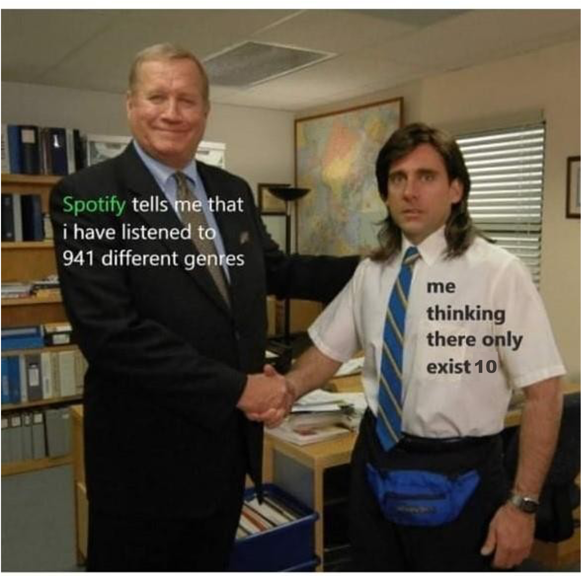
Thank You

